Slide 1








EVOLVE EDGE AI
EVOLVE EDGE AI
The AI-Powered Compliance Automation Platform
Transforming Compliance from Costly Obligation to Strategic Advantage
Kiel Green
evolveedgeai.com
Founder & CEO

Slide 2









The Problem
The Compliance Tax Is Killing Growth
For fast-moving organizations, traditional compliance is a manual, expensive bottleneck that delays revenue.
$150K–$500K
6–12 Months
50%+
Annual Consultant Fees
Audit Prep Delays
Team Capacity Wasted
Companies are forced to hire expensive external consultants for manual audit preparation, creating a massive recurring "compliance tax" on the bottom line.
Lengthy preparation cycles stall critical product launches, funding rounds, and enterprise deals while teams scramble to organize documentation.
Engineering and compliance teams lose over half their productivity to manual evidence collection, screenshots, and "document chasing" instead of building.
High-impact bottlenecks for regulated growth sectors:
Fintech
Healthtech
Enterprise SaaS

Slide 3








The Solution
Evolve Edge AI: Compliance on Autopilot
AI-Powered Evidence Collection
Proactive Auto-Remediation
Automatically gathers evidence across cloud (AWS, GCP) and enterprise systems (GitHub, Slack), eliminating manual "document chasing."
Goes beyond detection to actively fix compliance gaps. The system auto-patches controls and enforces security policies without human intervention.
Connects to 50+ Integrations
Unique Market Differentiator
Real-Time Compliance Dashboard
AI Audit Readiness Score
Continuous monitoring replaces periodic manual checks. visualize status across frameworks instantly with live risk detection.
Predictive analytics determine audit pass probability. The AI Auditor Copilot prepares reports and answers regulatory questions instantly.
Single Pane of Glass
Instant Audit Reports
85%+
Months → Days
$150K–$500K
Workload Reduction
Audit Prep Timeline
Annual Savings

Slide 4




MARKET OPPORTUNITY
A $2.9B Market Expanding Rapidly
Target Segments
Fintech
TAM
$1.3B → $2.9B
Banks, payment processors, and lending platforms facing strict PCI DSS & SOC 2 requirements.
→ $2.9B
Total Addressable Market (Global Compliance Automation)
Projected Growth (2026-2030)
CAGR 22%
Healthtech
Digital health providers and systems managing PHI requiring HIPAA compliance and data security.
SAM
$456M
Serviceable Available Market (U.S. Regulated Orgs)
Beachhead: Financial, Healthcare & Enterprise Software
Enterprise SaaS
$8M
B2B software vendors needing SOC 2 & ISO 27001 to close enterprise contracts and funding.
SOM
Serviceable Obtainable Market (Year 1 Target)
Initial capture via founder-led sales & early partnerships
Key Growth Driver
Organizations typically expand from 1 to 3+ frameworks within 24 months, creating built-in expansion revenue and high NRR potential.

Slide 5




















Competitive Landscape
The Only Platform That Fixes Compliance,
Not Just Tracks It
PLATFORM
Evidence
Collection
Gap
Remediation
Continuous
Monitoring
Audit Prep
Time
Consultant
Dependency
AI-Native
Architecture
Manual
None
Periodic
Manual Process
6-12 Months
Heavy ($150k+)
Automated
Tracking Only
Yes
Bolt-on
V
Vanta
Weeks
Moderate
Automated
Tracking Only
Yes
Bolt-on
D
Drata
Weeks
Moderate
Automated
Tracking Only
Yes
Bolt-on
S
Secureframe
Weeks
Moderate
RECOMMENDED
AI-Driven
Auto-Fix
Real-Time
AI-First
Evolve Edge AI
Days
Minimal
Full Capability
Partial / Limited
Missing
Evolve Edge AI is the only platform offering proactive auto-remediation.

Slide 6





























Product Deep Dive
The Platform: From Integration to Certification
Automated Evidence Collection
Zero-touch gathering of logs, configs, and user access reviews from integrated systems.
Proactive Auto-Remediation
AI detects gaps and automatically applies fixes (e.g., closing open ports, enforcing MFA).
Real-Time Dashboards
AI Core Engine
Frameworks
Doc Library
Audit Ready
Live view of compliance posture with instant alerts on drift or policy violations.
Cloud Sources
• Continuous Monitoring
HIPAA
PCI DSS
• Policies
• Audit Report
• Auto-Patching
SOC 2
ISO 27001
• Evidence
• Readiness Score
• Risk Detection
FedRAMP
• Vendor Mgmt
• Certification
Cross-Framework Mapping
Map one control to multiple frameworks (collect once, comply many).
Instant Reporting
Generate audit-ready packages and auditor-specific views in seconds.

Slide 7









Business Model
Simple, Scalable SaaS Pricing
Most Popular
Basic
Pro
Enterprise
10K
50K
80K+
$
$
/yr
$
/yr
/yr
Entry-level compliance automation
For growing mid-market teams
Full-scale organizational security
1 Compliance Framework
Up to 3 Frameworks
Unlimited Frameworks
Up to 5 Users
Up to 25 Users
Unlimited Users
Core Dashboards
Proactive Auto-Remediation
FedRAMP Roadmap Access
AI Chatbot Support
Full API Access
SSO / SAML Integration
Manual Evidence Upload
Priority Support
White-Glove Onboarding
Cloud Integrations (AWS, GitHub)
Dedicated Success Manager
Modular Add-Ons
$500 – $5,000 / module
Extra frameworks, advanced features, and custom integrations available as needed
/ module

Slide 8








Traction & Validation
Market Validation: Demand Is Real
Strong early indicators confirm urgent market need for automated compliance.
50%
20%
"If you can truly auto-fix controls instead of just flagging them, we'll buy yesterday. The manual remediation is killing our velocity."
Of interviewed orgs ready to purchase immediately
Plan to purchase in near-term roadmap
$482K
Expertise
CTO
Chief Technology Officer
Mid-Market Fintech Co.
Pre-seed funding target (SAFE Note)
Founder-led PCI DSS + HIPAA deep domain experience
Path to Initial Traction
Pilot Programs
Launch MVP
10 Paying Customers
Profitability
High-touch onboarding
HIPAA + PCI DSS Live
Month 3 Milestone
Year 1 Target

Slide 9











Go-To-Market Strategy
Founder-Led Sales to Market Leadership
A structured three-phase approach to capture the $8M SOM beachhead and scale.
Phase 1
Phase 2
Phase 3
Beachhead
Scale
Leadership
Months 0 – 6
Months 6 – 18
Years 2 – 3
Key Activities
Key Activities
Key Activities
Founder-Led Outbound: High-touch sales led by CEO Kiel Green
Channel Partnerships: Launch MSP & Consultant portal
Product Moat: Launch AI Auditor Copilot
Expansion: Enter European market (GDPR/NIS2)
Target Verticals: Fintech, Healthtech, & Enterprise SaaS
Cloud Marketplaces: AWS & Azure Marketplace listing
Government: FedRAMP certification readiness
Pilot Programs: Convert beta users to annual contracts
Content Engine: LinkedIn thought leadership & webinars
Category Definition: Establish "Continuous Remediation"
Direct Integrations: Leverage AWS/GitHub ecosystem
Sales Team: Hire first 2 Account Executives
Milestone Target
Milestone Target
Milestone Target
10 Paying Customers & MVP Validation
$1M+ ARR & SOC 2 Type II Launch
$5M+ ARR & Series A Funding
Validating Product-Market Fit
Building Distribution Engine
Dominating Category

Slide 10















Product Roadmap
From MVP to AI-Native Compliance Platform
MVP Launch
Year 1
Year 2
Year 3
LIVE NOW
IN DEV
PLANNED
VISION
Foundation
Expansion
AI Intelligence
Autonomous
HIPAA + PCI DSS
SOC 2 + ISO 27001
AI Auditor + FedRAMP
Self-Healing Platform
Automated Evidence Collection
Cross-Framework Mapping
AI Auditor Copilot
Self-Healing Compliance
Risk Detection Engine
External Auditor Portal
Regulatory Q&A Automation
AI Copilot v2.0
Compliance Dashboards
MSP Partner Dashboard
Predictive Compliance
International Frameworks
HIPAA
PCI DSS
SOC 2
ISO 27001
+ Azure Integration
FedRAMP
GDPR
Series A
Global Scale

Slide 11


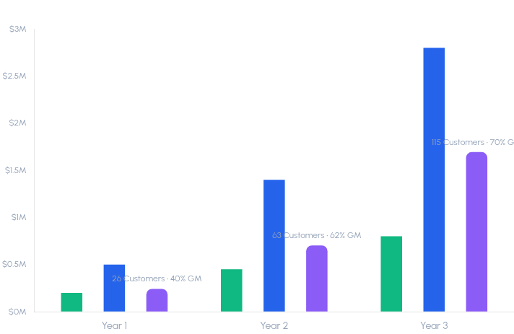


Financial Projections
Path to $5.3M ARR in Year 3
Annual Recurring Revenue (ARR) Growth
Basic ($10K)
Pro ($50K)
Enterprise ($85K+)
Year 1
Profitability Target
Achieved via low CAC founder-led sales
120%+
Net Revenue Retention (NRR)
Driven by multi-framework expansion
8:1
LTV / CAC Ratio
High efficiency unit economics

Slide 12

















The Team
Built by Compliance Experts Who've Lived the Pain
Strategic Approach
Kiel Green
Domain-Led Product: Building solutions for specific pain points experienced firsthand in regulated industries.
Founder & CEO
Customer Development: Hands-on founder sales to validate MVP and secure early pilot partners.
Deep domain expertise in regulatory compliance frameworks with a proven track record of leading security initiatives. Combining technical cloud security knowledge with strategic compliance leadership to solve the manual audit burden.
Fast Iteration: Agile development cycles focused on rapid feedback from beachhead customers.
Compliance Leadership
Cloud Security
Current Advisory Needs
PCI DSS & HIPAA Expert
AWS/Azure Architecture
Enterprise SaaS Sales Coach
Founder-Led Sales
Technical Product
High-Touch GTM Strategy
AI-Native Vision
FedRAMP / 3PAO Expert
Contact for Investor Inquiries:
k.green@evolveedgeai.com
Series A Fundraising Strategy

Slide 13




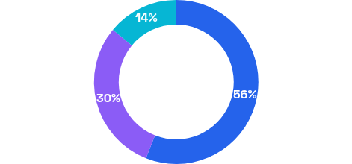


The Opportunity
Join Us in Transforming Compliance
$482K - $700K
Key Milestones
SAFE Note
Pre-Seed Raise
Launch Commercial Platform
Complete MVP with HIPAA & PCI DSS support
Acquire First 10 Customers
Use of Funds
Validate product-market fit with paying users
Reach Profitability (Month 12)
Achieve break-even & $8M SOM target
Scale Technology
Release SOC 2, Azure integration & AI Copilot Beta
Product Development (56%)
$269,920
Series A Potential
AI engine, Integrations, Frameworks
$20M - $40M Valuation
Operations & Compliance (30%)
$144,600
Infrastructure, Legal, Security
Positioned for high-multiple Series A based on $5M+ ARR trajectory and AI-native differentiation vs legacy players.
Sales & Marketing (14%)
$67,480
GTM, Content, Outreach

Slide 14







Ready to Make Compliance a
Competitive Advantage?
The future of compliance is continuous, automated, and AI-native.
$1.3B → $2.9B
85%+
$150K - $500K
Massive market growth projected by 2030
Workload reduction for every customer
Saved annually vs traditional compliance
KG
Kiel Green
k.green@evolveedgeai.com
Schedule a Demo | Request Investor Materials
Founder & CEO
evolveedgeai.com

